Slide 1
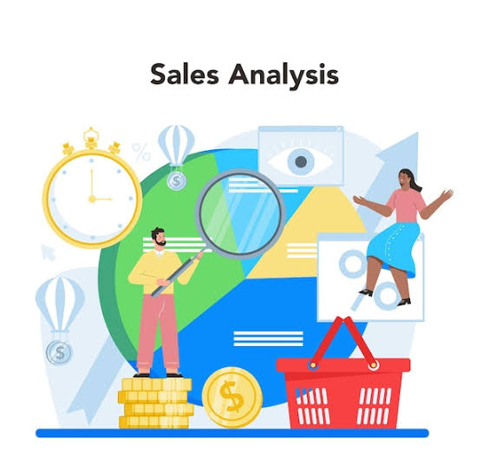
Sales Insights in Data Science
MINOR PROJECT PRESENTATION
PRESENTED BY: SAHIL TRIPATHI

Slide 2

INTRODUCTION
OVERVIEW: Sales data is a critical asset for businesses, providing insights into customer behavior, sales trends, and market dynamics.
Data science offers advanced techniques to analyze and interpret this data, uncovering patterns and predicting future trends.
OBJECTIVE: The primary goal of this project is to utilize data science methods to extract actionable insights from sales data, helping businesses make informed decisions.
RELEVANCE: Effective analysis of sales data can lead to improved customer targeting, optimized inventory management, and enhanced overall sales performance.

Slide 3
LITERATURE SURVEY
OVERVIEW: - Review of key research in sales data analysis.
KEY STUDIES: 1. *Predictive Analytics for Sales Forecasting* - Method: ARIMA models.
Outcome: Improved sales trend predictions
2.Customer Segmentation Using Clustering Techniques - Method: K-means clustering.
Outcome: Identified high-value customer segments.
3. Impact of Marketing Campaigns on Sales - Method: Regression analysis.
Outcome: Positive correlation between campaigns and sales growth.
GAPS IN RESEARCH: Limited real-time data integration.
- Underuse of advanced machine learning techniques.
- Need for comprehensive multi-source approaches.

Slide 4
PROBLEM STATEMENT
CURRENT CHALLENGES: - Data Silos: Sales data scattered across multiple systems.
Lack of Real-Time Analysis: Delayed insights affecting decisions.
Predictive Accuracy: Traditional methods lacking precision in forecasting.
SPECIFIC PROBLEMS: Objective: Create a comprehensive data science solution to integrate sales data, enable real-time analysis, and enhance predictive accuracy for actionable business insights.

Slide 5

PROPOSED SOLUTION
APPROACH: Data Integration: Unify sales data from multiple sources.
- Real-Time Analysis: Employ tools for real-time processing.
Predictive Modeling: Apply advanced machine learning for accurate forecasts
METHODOLOGY: 1. Data Collection: CRM systems, transaction logs, etc.
2. Data Preprocessing: Cleaning and preparation.
3. Model Building: Train machine learning models.
4. Evaluation: Test and refine models.
TOOLS: - Integration & Analysis: SQL.
Manager Tableau

Slide 6
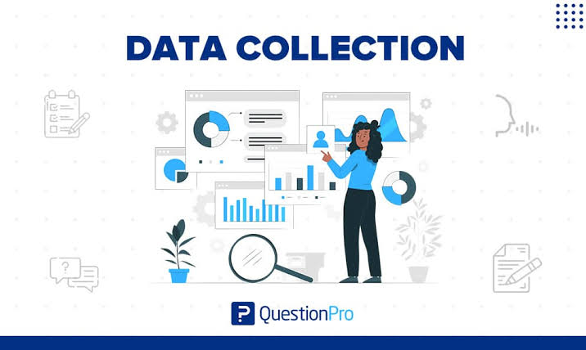
DATA COLLECTION AND PREPROCESSING
DATA SOURCES: - CRM Systems: Customer relationship management data.
- Transaction Logs: Sales records.
External Data: Market trends and economic indicators.
PREPROCESSING STEPS: 1. Data Cleaning: Handle missing values and duplicates.
2. Data Transformation: Normalize and scale data.
3. Feature Engineering: Create new features to enhance model performance.

Slide 7
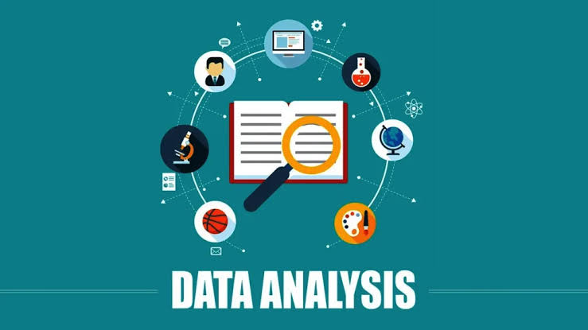
EXPLORATORY DATA ANALYSIS [EDA]
KEY INSIGHTS:
Sales Trends: Seasonal patterns and growth trends identified.
Customer Behavior: Insights into purchasing patterns and customer segments.
Product Performance: Sales performance comparison across products.
VISUALIZATIONS:
Line Charts: Display sales trends over time.
Bar Charts: Compare sales of different products.
Heatmaps: Highlight customer purchasing patterns.

Slide 8

RESULTS AND DISCUSSION
INSIGHTS:
Key Drivers: Price, seasonality, and promotions were major factors influencing sales.
Customer Segments: High-value customer segments identified for targeted marketing.
Sales Forecasts: Enhanced forecasts aiding better inventory and marketing strategies.
KEY DRIVERS: Price, seasonality, and promotions were major factors influencing sales.
CUSTOMER SEGAMENTS: High-value customer segments identified for targeted marketing.
SALES FORECAST: Enhanced forecasts aiding better inventory and marketing strategies.

Slide 9

CONCLUSION
In our analysis of sales data, several key insights have emerged:
*Sales Trends*: We observed a consistent upward trend in sales over the past year, with significant spikes during the holiday season. This suggests strong seasonal demand which can be leveraged for targeted marketing campaigns.
2. Customer Segmentation: Our customer segmentation analysis identified three primary segments: high-value repeat customers, occasional buyers, and first-time purchasers. Tailored marketing strategies for each segment can enhance customer retention and acquisition efforts.
3. Product Performance: Certain products consistently outperformed others, particularly in categories related to technology and home goods. This highlights opportunities for product line expansion and focused promotional efforts on high-demand items.
4. Geographic Insights: Sales performance varied significantly across different regions, with urban areas showing higher sales volumes compared to rural areas. This geographic disparity underscores the need for region-specific marketing and distribution strategies.
5. Channel Effectiveness: Online sales channels outperformed brick-and-mortar stores, reflecting a shift in consumer purchasing behavior towards e-commerce. Strengthening online presence and optimizing digital marketing will be crucial moving forward.

Slide 10
RECOMMENDATIONS
Based on these insights, we recommend the following actions:
1. Seasonal Promotions: Develop and implement aggressive marketing campaigns around key holiday periods to capitalize on peak sales opportunities.
2. Targeted Marketing: Utilize customer segmentation data to create personalized marketing messages and loyalty programs tailored to each customer segment's preferences and behaviors.
3. Product Strategy: Focus on expanding high-performing product lines and consider phasing out underperforming items to optimize inventory and profitability.
4. Regional Focus: Allocate marketing resources more effectively by tailoring strategies to high-potential regions, and explore ways to boost sales in lower-performing areas.
5. E-commerce Optimization: Invest in enhancing the online shopping experience, including website optimization, mobile app improvements, and targeted digital advertising campaigns to drive online sales growth.
By implementing these recommendations, we can enhance our sales performance, better meet customer needs, and sustain long-term business growth.---

Slide 11

REFERENCES
Some of the sources used for the Minor Project :
Webinars and Online Courses
Online articles and blogs

Slide 12
THANKYOU.

